Slide 1
Zoom Guide

Slide 2
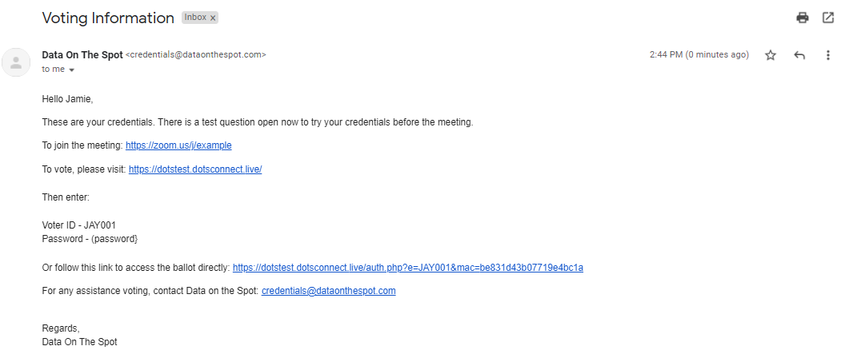
Joining The Meeting
Click the link beside the text “To join the meeting” in the email you received from credentials@dataonthespot.com

Slide 3
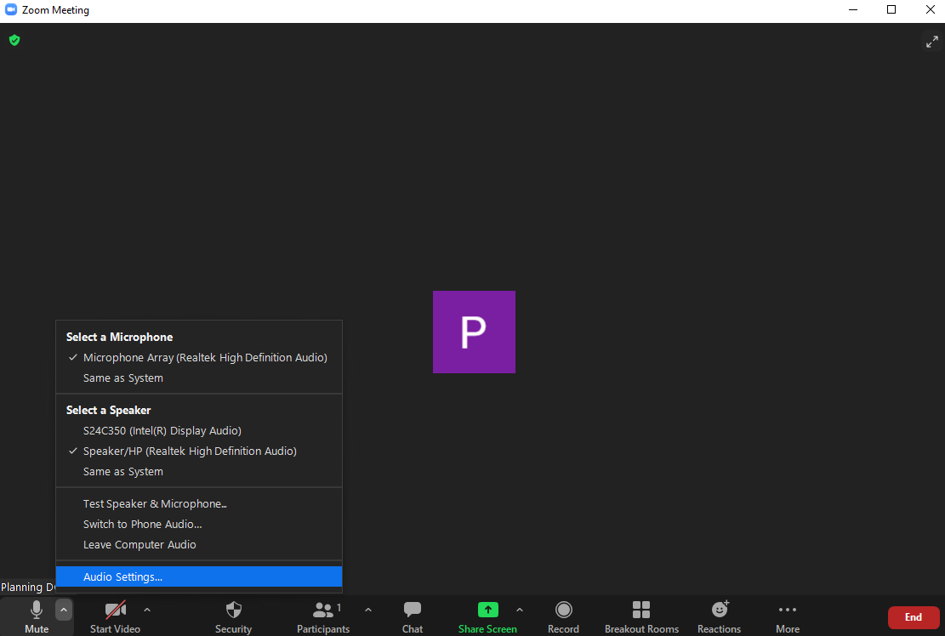
Connecting your Microphone
To ensure the best experience make sure your audio settings are correct. These can be found by clicking the small arrow next to the Microphone icon

Slide 4
Change your name (PC)
Step 1: To change your name after entering a Zoom meeting, click on the “Participants” button at the bottom of the Zoom window.
Step 2: Next, hover your mouse over your name in the “Participants” list on the right side of the Zoom window. Click on “Rename”.

Slide 5
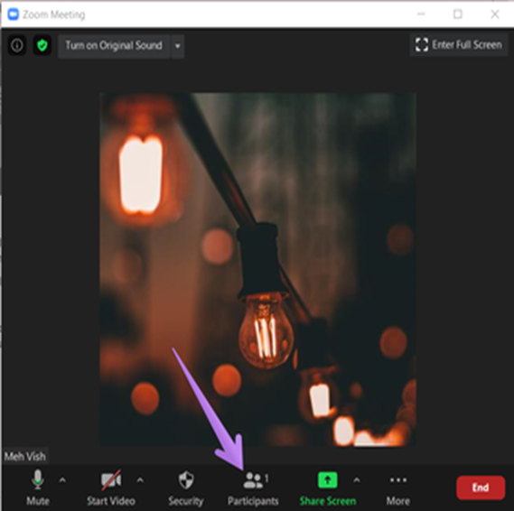
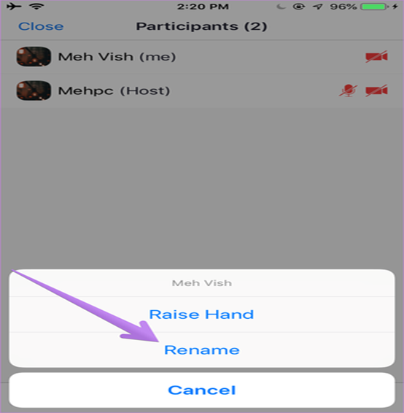
Change your name (Mobile)
Mobile
Step 1: To change your name after entering a Zoom meeting, click on the “Participants” button at the bottom of the Zoom window.
Step 2: Tap on your name and choose Rename from the menu.

Slide 6
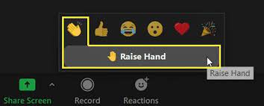
Participating in Discussion (PC)
If you wish to speak at any point during the Conference, you will need to use the Raise Hand feature in Zoom to be put on the speakers list and be recognized by the Chair.
This will put you in a cue. When you are called on by the chair, you will be allowed to unmute. Please unmute yourself and begin speaking.
To Move/Second a Motion, you can also use the raise hand feature.
To raise a point of order/privilege, please use the chat function.

Slide 7
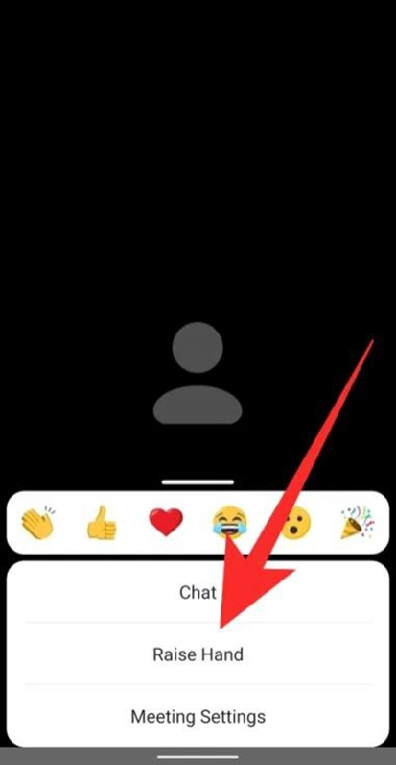
Participating in Discussion (Mobile)
Mobile
1. To raise your hand to speak up, tap on the ‘More’ button from the meeting controls at the bottom right corner of the screen.
2. Select the ‘Raise Hand’ option from the popup menu.

Slide 8
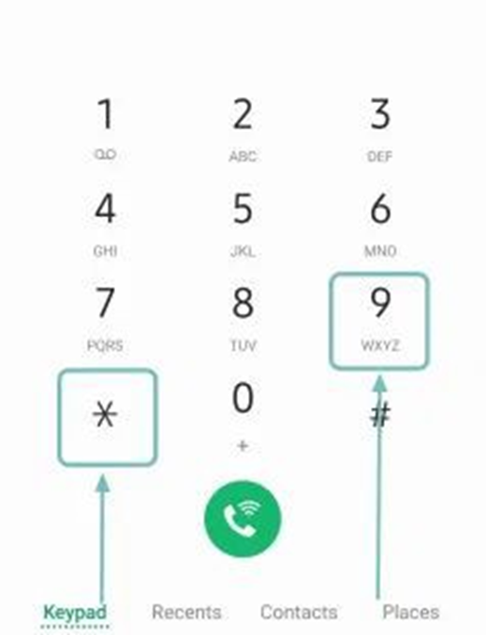
Raising your hand through dial-in
Mobile
Zoom allows users to dial into meetings directly from a phone, without the use of an application. To do so:
1. Dial *9 on their phone’s dial pad.
2. To lower hand, participant must once again dial *9 on their phone’s dial pad.

Slide 9
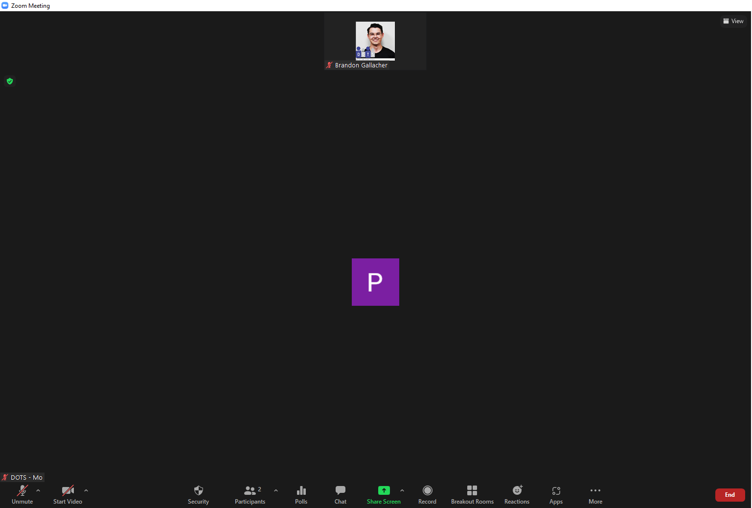
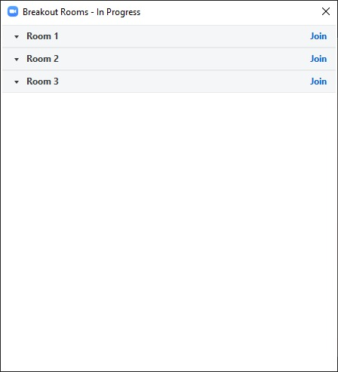
Joining a Breakout Room (PC)
Locate the “Breakout Room” icon on the lower portion of your screen
If you are not already assigned, Please click “Join” on the appropriate breakout room

Slide 10
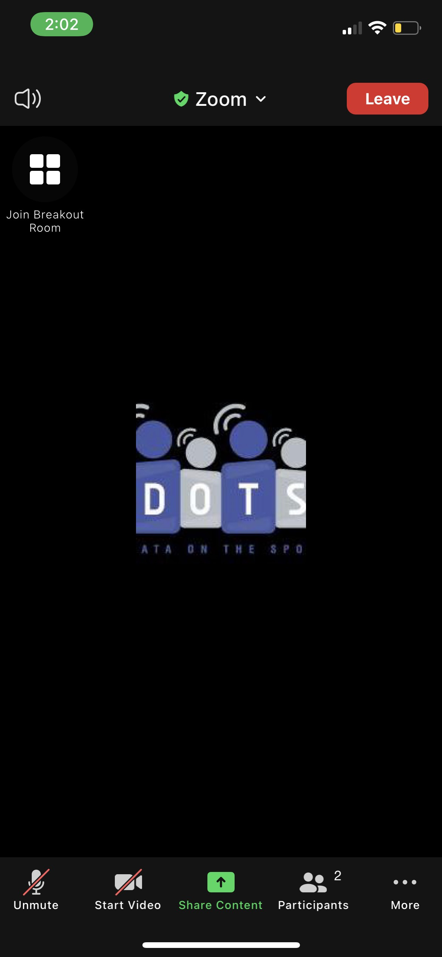
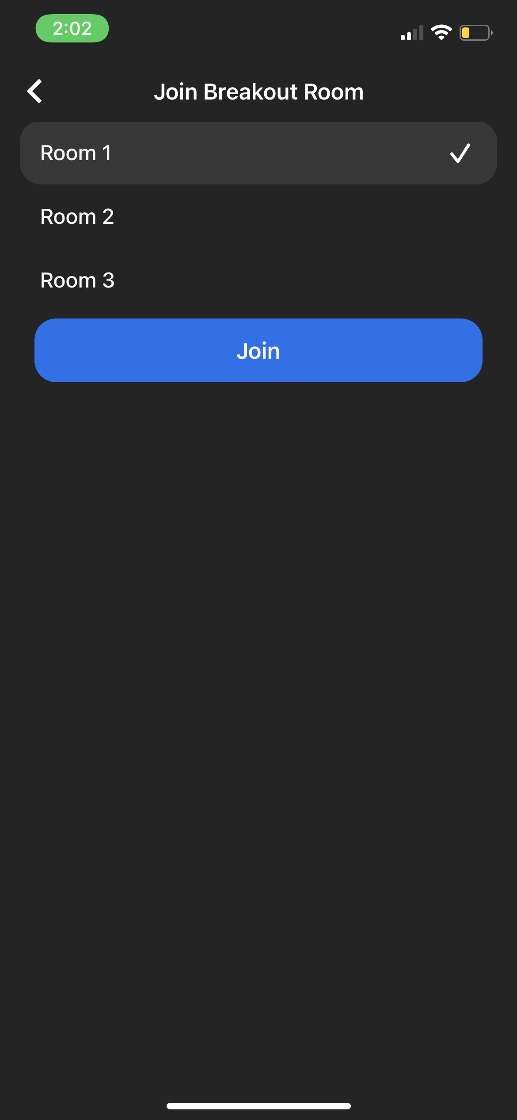
Joining a Breakout Room (Mobile)
Mobile
Locate the “Breakout Room” icon on the lower portion of your screen
If you are not already assigned, Please click “Join” on the appropriate breakout room

Slide 11
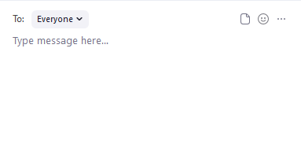
Using the Chat function (PC)
Type your message and press enter. You may choose to send your message to one person or to everyone using the drop-down menu
Locate the “Chat” icon on the lower portion of your screen

Slide 12
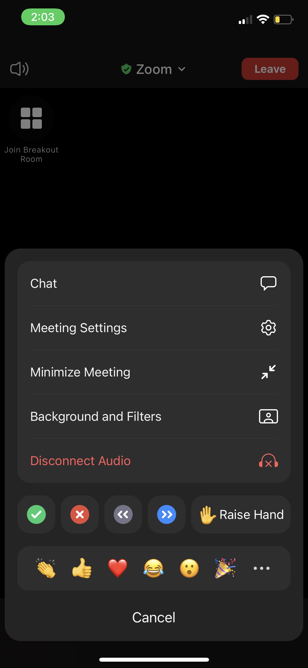
Using the Chat Function (Mobile)
Mobile
Type your message.
You may select the send your message to everyone or choose an individual.
Locate the “More” icon in the lower right of your devices screen
Find and prompt the “Chat” icon

