Slide 1
Your Union
2022
Notes:
General introductions – welcoming and friendly
If possible, try to put faces to names of local reps and shop stewards so the new member can easily identify these union reps in their workplace or community. Members are more likely to talk to people they have met personally or can identify in person rather than by name on a list.
It is important to use inclusive language in your orientation. Try using “we” and “your union” as opposed to “the union” or “NAPE”.
Please have a copy of your specific agreement on hand for the orientation.

Slide 2
NAPE – YOUR union!
NAPE stands for Newfoundland And Labrador Association Of Public And Private Employees.
The largest Union in the province representing over 25,000 Public and Private employees.
Notes:
In becoming a NAPE member you are uniting with over 25,000 public and private sector workers across our great province.
Unions are built on the fundamental principle that we are stronger when we work together – that there is strength in numbers. Alone, each worker must negotiate and deal with their employer as an individual. By working together, workers have a more powerful collective say about their working conditions, health and safety, pay and benefits.
Through its collective voice, the union movement has been able to accomplish much for workers. In fact, many of the working conditions that all workers in our society enjoy is because of the work of the labour movement over the years; health and safety standards, maternity leave, pensions, minimum wage, the 40 hour work week, weekends, and the list goes on and on.
In NAPE you have joined a strong voice for you and your family. Our union has a proud and rich history of defending its members, negotiating good collective agreements, advocating for strong public services, and fighting to improve the lives of workers and their families.

Slide 3
Strength in Numbers
Notes:
Unions make a difference both at work and in the quality of life.
The labour movement was created by people standing up together for fair wages, safe workplaces and decent work hours.
You are not alone!
Many of the benefits and standards won for our members are enjoyed by all workers today, such as minimum wage, health and safety regulations, maternity and parental leave, and overtime.
Having a union on your side makes your job and your workplace safer and fairer. You get paid better and are more likely to have benefits that help you balance work with life at home. Your health and ability to do your job become important and your right to fair treatment gets enforced.

Slide 4
The Union Advantage
Better pay and benefits
Safer working conditions
Collective say in your work
Representation
Fair process
Notes:
By working together, you have access to increased protections and rights some of which are listed here.
Walk through some of the benefits and how the union achieves them (as time allows).

Slide 5
Member Services
Professional staff and negotiators
Two lawyers on staff
Dedicated health and safety expert
Communications and campaigns
Education program
Notes:
NAPE is the largest union in Newfoundland and Labrador – proudly uniting over 25,000 public and private sector workers. Because of our collective strength, we are able to pool our resources and provide high quality services and benefits to members. It also means that we are a powerful agent for positive change in the province – at the bargaining table and in our communities.
Few unions can match the range of membership services NAPE provides. These include:
• professional staff to deal with grievances and problems in the workplace;
• skilled negotiators to bargain contracts;
• two lawyers on staff to protect you and your rights in the workplace;
• a dedicated health and safety expert and advocate;
• communications and campaigns to make sure members know what’s going on – and to win public support for your issues;
• shop Steward training and professional development;
• a comprehensive education program to help members know their rights, defend themselves and each other, and develop skills to be leaders within our union;

Slide 6
Member Services
Advantage Discount Program
Grievance Process
Scholarships
Three offices – St. John’s, GFW, Corner Brook
Notes:
Walk through these as time allows.
Details are available on the NAPE website.

Slide 7
What is a local?
Your Local is composed of unionized members in one or more workplaces.
Members elect an executive to run the local in a democratic process.
Usually consists of a President, Secretary, Vice President, etc…
Each local has by-laws that govern how decisions are made, composition, etc…
Hold regular membership meetings.
Deal with workplace problems, grievances, collective bargaining and other issues related to the union movement at the workplace level.
Elect delegates to attend various labour conventions.
Financed by membership dues.
Notes:
Your Local
This is a good opportunity to talk about how your local works, how decisions are made, who the executive is, introduce them (if possible), what your local number is, etc…

Slide 8
Locals
What does your local number mean?
Let’s look at Local 6206
First digit is 6 - is for region number in this case region 6 (St. John’s).
Second digit is 2 – is the component number 2 (Hospital Support Staff)
Third and fourth digits are the number of locals in your region for that component.
It is the sixth local formed in that region.
Notes:
Run through how the local got its number (you can change the example provided to your local if you like.

Slide 9
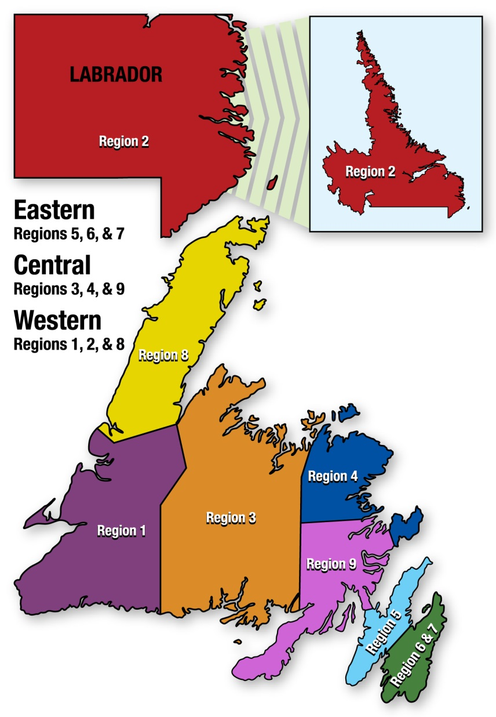
Notes:
NAPE is YOUR union. Decisions are made democratically by the members through conventions and elections.
NAPE has been built by members to ensure that everyone has an opportunity to be heard and to contribute to any of the decisions the union makes.
Locals are organized into geographic regions
Components are groupings of workers based on bargaining unit or similar work profiles
(run through your local region and components of NAPE)

Slide 10
Democracy in Action
Notes:
Board of Directors / Executive: Strong Leadership for a Strong Union
The Board of Directors are the elected leadership of the Union.
The Executive is comprised of:
President
Secretary Treasurer
General Vice President
Western, Central, and Eastern Vice President
The President and Secretary-Treasurer are elected directly by the members every three years via mail in ballot. They are the paid, full time directors of the Union.
The remainder of the Board is comprised of area, component, and region representatives who are elected at NAPE’s Biennial Convention or at their respective Component Conventions.
A full listing of the current Board of Directors can be found on NAPE’s website at www.nape.ca

Slide 11
Democracy in Action – Conventions
Component Conventions
Biennial Conventions
Notes:
NAPE is founded on democratic decision making from the members up.
Decisions for the union are made at conventions.
Members are elected to go from the local as delegates.
Motions and resolutions are voted on by delegates from the various locals.
Conventions are the ultimate decision-making body of the union.

Slide 12
Democracy in Action - Affiliations
CLC / NUPGE
NAPE
LOCAL
YOU
NLFL
Notes:
NAPE represents you in your workplace and is active at the provincial level in standing up for your rights and the working conditions, products, and services that you provide.
However, decisions are made by governments at the provincial and federal level which have an impact on you, your job, your working conditions, etc.
To help ensure that workers have a voice at these levels of decision making, NAPE is affiliated with the following labour organizations:
Newfoundland and Labrador Federation of Labour (NLFL) - The Newfoundland and Labrador Federation of Labour has a proud history of representing the interests of union members and workers since 1936. The Federation of Labour is made up of nearly 30 affiliated unions, 500 locals and six District Labour Councils. We represent more than 65,000 working women and men from every sector of our economy and from every community in our province.
National Union of General And Public Employees (NUPGE) (National Union) - The National Union of Public and General Employees (NUPGE) is a family of 11 component and 3 affiliate unions. Taken together we are one of the largest unions in Canada. Most of our 390,000 members work to deliver public services of every kind to the citizens of their home provinces. We also have a large and growing number of members who work for private businesses.
Canadian Labour Congress (CLC) - Canada’s largest labour organization, bringing together dozens of national and international unions, provincial and territorial federations of labour and community-based labour councils to represent 3.3 million workers.

Slide 13
Collective Agreement
A collective agreement is a written agreement that states the duties of the employee and employer and ensures compliance with the regulation of scheduling, holidays, general work conditions, health and safety, and rate of pay.
It sets out the ground rules at work – for you and for your employer.
It also sets out processes to resolve workplace issues (grievances)
Copies of the collective agreement can be requested from your NAPE representative, or found online at www.nape.ca.
Notes:
This is a good opportunity to bring up articles of the agreement specific to your workplace that are particular relevance/importance to the new member.

Slide 14
Who Negotiates My Agreement?
Prior to the expiry date of your contract, you will be invited to attend a union meeting. At the union meeting you will be asked for suggestions for changes you want to see made to your contract. You will also be asked to elect your negotiating team (if your bargaining unit is small) or to elect delegates to your Component Convention or negotiating meeting (if your bargaining unit is big).
If your bargaining unit is large, your suggestions for your next contract will be presented at your Component Convention or negotiating meeting as resolutions, debated and either passed or rejected. Your bargaining unit’s negotiating team will be elected from the delegates to your Component Convention or negotiating meeting.
A NAPE staff person, who has training and expertise in collective agreement bargaining is assigned to work with the bargaining team to provide support.
The bargaining team negotiates with your employer on your behalf.
In the end – every member gets a say in the agreement via a secret ballot vote.
Notes:
This is a good opportunity to talk about the bargaining process as it relates to your workplace. Where you are in the current bargaining cycle. Etc…

Slide 15
Bargaining Units
NAPE has over 100 bargaining groups
This means there are over 100 different NAPE collective agreements throughout Newfoundland and Labrador.
Notes:
Please go through what bargaining unit the member now belongs in.

Slide 16
Employee Rights
Safe work environment
Union access
Union representation
Grievance Procedure
Notes:
Walk through some of the specific language in your agreement that deals with these issues/articles.

Slide 17
Grievance Process
The Grievance process varies depending on the workplace and the collective agreement language, and it is up to the Shop Stewards and NAPE Servicing Representatives to file and resolve these grievances
Notes:
Opportunity to discuss grievance process and some usual examples at your workplace (as time allows).

Slide 18
Roles
Shop Steward
Enforce Collective Agreement
Deal with Complaints
Settle Grievances
Notes:
Your shop steward is someone who works in your workplace, and is your first contact in case you need help with anything related to your working conditions or collective agreement.
Elected or appointed within the Local, Stewards enforce the collective agreement and protect the rights acquired by members through negotiations and other union actions. Thus, Shop Stewards are your first line of defence, as they are responsible for enforcing contracts, handling grievances, ensuring worksite safety, mobilizing members for political campaigns, orienting new members to the worksite and NAPE, and more.
They also act as a line of communication from your union – they generally bring the latest news about upcoming education opportunities, bargaining news, and other information from your local.
Along with their duties in regard to the union and the workplace, the Stewards also act as the liaison between the Local Executive and the membership. It is their job to make sure the members they represent at the worksite know what the union and Local are doing.

Slide 19
Roles
NAPE Servicing Reps (LRSs, EROs, MSOs) – NAPE STAFF
Negotiations
Servicing various locals
Grievance handling
Mediation
Arbitration
Notes:
In addition to your steward, NAPE has trained professional staff working on your behalf to solve your workplace issues through the grievance process set out in your contract.
NAPE Servicing Reps are the staff people responsible for servicing you. They are experts in your collective agreement, employer/employee relations, grievances, and negotiations.
When issues can’t be resolved by your Shop Steward, a NAPE Servicing Rep is always available to provide advice and assist you in any way necessary.
ERO = Employee Relations Officer
MSO = Membership Servicing Officer
LRS = Labour Relations Specialists

Slide 20
Follow the Steps!
Notes:
If you have an issue in the workplace, please follow the steps!
To ensure your issue is dealt with quickly as well as to ensure that the right people know about it at the right time, please make sure to follow the steps if you have questions, comments, concerns or a possible grievance in your workplace.
Talk to your shop steward (always the first step)
Talk to your Local Officers
Contact one of the NAPE offices to talk to a staff person
Contact a NAPE Board or Executive member

Slide 21
Membership Cards
Proof of Membership
Ability for NAPE to send you info
Ability to vote
Advantage Discount Program
If you don’t have one – contact NAPE office
Notes:
It is important that you fill out and submit your NAPE Membership Card. The card is your proof of membership, entitles you to vote in NAPE elections, and ensures that your union has your most up to date contact and employment information.
If you have not done so already, please get the member(s) to fill out the card during your orientation session and then submit it directly to NAPE following the meeting.

Slide 22
NAPE Advantage Program
NAPE members are eligible for discounts at various places throughout the province. All you have to do is show your NAPE membership card.
A full list of participating locations can be found online.

Slide 23
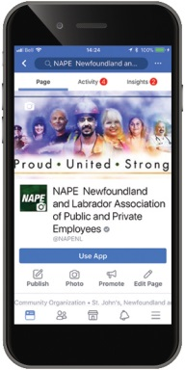
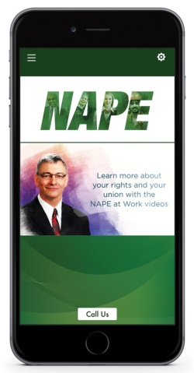
Communications
Facebook Page (most frequent updates)
www.facebook.com/NAPENL
Website (frequent updates)
www.nape.ca
Newsletter/Mail Outs (Communicator)
Email list
NAPE App (search NAPE on Apple or Android store to get it from NAPE website)
Notes:
Communicating with our members is something that our union prides itself on. Ensuring that members know what’s going on with their union as well as the ability to effectively and efficiently get in touch with Union representatives is paramount to a successful union.

Slide 24
Thank You Questions?

